Slide 1
Tutorial-3 Questions
CS-206

Slide 2
Number system conversion
Q.1. Decimal to Binary conversion of following numbers: a)0.188, b)410
Q.2. Hexadecimal to decimal of 257.AB
Q.3. Hexadecimal to binary of 3ACF7
Q.4. Octal to decimal of (a) 531 (b) 320.127
Q.5. Decimal to octal of 316.32

Slide 3
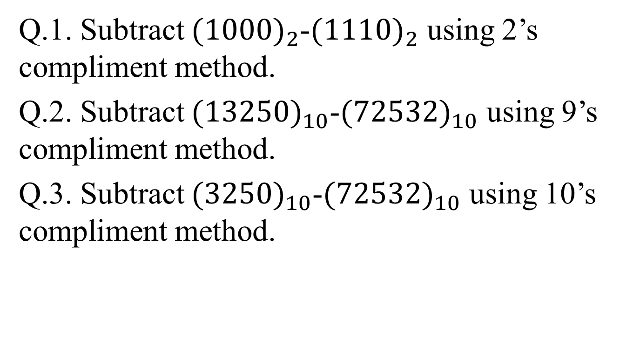
Subtraction using Complement method
Q.1. Subtract ${(1000)}_{2}$-${(1110)}_{2}$ using 2’s compliment method.
Q.2. Subtract ${(13250)}_{10}$-${(72532)}_{10}$ using 9’s compliment method.
Q.3. Subtract ${(3250)}_{10}$-${(72532)}_{10}$ using 10’s compliment method.

Slide 4
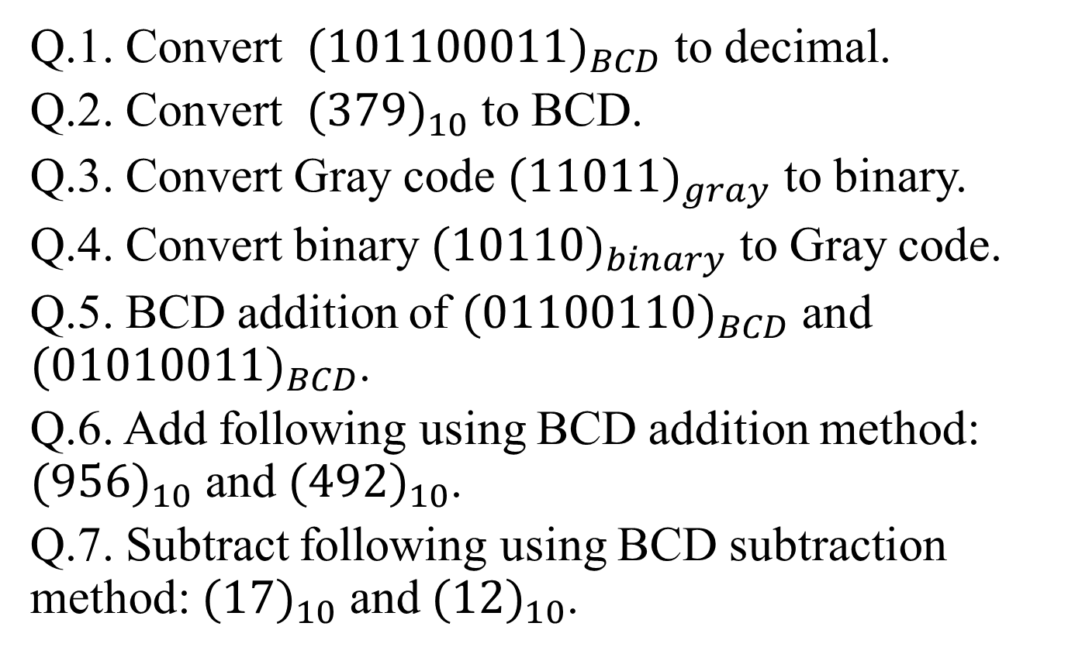
Code Conversion and BCD Addition/ Subtraction
Q.1. Convert ${(101100011)}_{BCD}$ to decimal.
Q.2. Convert ${(379)}_{10}$ to BCD.
Q.3. Convert Gray code ${(11011)}_{gray}$ to binary.
Q.4. Convert binary ${(10110)}_{binary}$ to Gray code.
Q.5. BCD addition of ${(01100110)}_{BCD}$ and ${(01010011)}_{BCD}$.
Q.6. Add following using BCD addition method: ${(956)}_{10}$ and ${(492)}_{10}$.
Q.7. Subtract following using BCD subtraction method: ${(17)}_{10}$ and ${(12)}_{10}$.

